Slide 1
BLUESTOCK MUTUAL FUND
ANALYTICS CAPSTONE
End-to-End Data Engineering, Dashboarding & Risk Analysis
Submitted By: Damodara P
Data Analyst Intern | Bluestock Fintech
pdamodaran2000@gmail.com | June 2026

Slide 2
Problem Statement & Objectives
The Challenge: The Indian Mutual Fund industry manages Rs.81 Lakh Crore across 1,900+ schemes. Retail investors lack accessible, data-driven tools to compare risk-adjusted fund performance and make informed investment decisions.
Objective 1 - Data Pipeline: Build an automated ETL pipeline to ingest, clean, validate, and store 17 raw datasets (127,000+ rows) into a structured Star Schema SQLite database.
Objective 2 - Performance Analytics: Calculate CAGR (1yr/3yr/5yr), Sharpe Ratio, Sortino Ratio, Alpha, Beta, Maximum Drawdown, VaR, and CVaR for 40 mutual fund schemes.
Objective 3 - Interactive Dashboard: Develop a 4-page interactive Power BI dashboard with KPI cards, scatter plots, drill-through navigation, slicers, and tooltips.
Objective 4 - Recommendation Engine: Build a Python-based algorithmic fund recommender that maps investor risk profiles (Low/Moderate/High) to optimal funds using Sharpe Ratio rankings.
Objective 5 - Investor Intelligence: Perform cohort analysis, SIP continuity tracking, and demographic segmentation to identify at-risk investors and growth opportunities.
Timeline: 7-day intensive capstone project covering data ingestion through final reporting.
Bluestock MF Analytics | Damodara P | June 2026

Slide 3
Data Sources & Architecture
10 Core Datasets Ingested: Fund Master (40 schemes), NAV History (64,320 records), AUM by Fund House (90 records), Monthly SIP Inflows (48 months), Category Inflows (144 records), Industry Folios (21 snapshots), Investor Transactions (32,778 records), Benchmark Indices (8,050 records).
Total Data Volume: 127,000+ rows across 17 files including individual fund NAV CSVs and combined scheme data for 6 major AMCs spanning Jan 2022 to Dec 2025.
Star Schema Database: Fact tables (fact_nav, fact_transactions, fact_performance) + Dimension tables (dim_fund with 40 schemes, dim_date with 1,608 date entries) loaded into bluestock_mf.db SQLite database.
100% Data Validation: Automated row-count checks confirmed zero data loss across all 11 tables. AMFI code cross-validation achieved 100% match rate between Fund Master and NAV History.
Tech Stack: Python 3.14 (Pandas, NumPy, SciPy, Matplotlib, Seaborn, Plotly), SQLite3, Jupyter Notebooks, Power BI Desktop, Git/GitHub for version control.
Data sourced from AMFI (Association of Mutual Funds in India) and supplementary financial data providers.
Bluestock MF Analytics | Damodara P | June 2026

Slide 4
System Architecture: ETL Pipeline
EXTRACT (Day 1): Python script (data_ingestion.py) automatically scans data/raw/ directory, validates file integrity, detects 17 files with 127,177 total rows, generates a comprehensive data quality report, and cross-validates AMFI codes across all tables.
TRANSFORM (Day 2): Column standardization to snake_case, datetime parsing, removal of zero-NAV anomalies, deduplication using keep-last strategy, and dynamic generation of dim_date table with Year/Quarter/Month/FY flags (1,608 rows).
LOAD (Day 2): Cleaned DataFrames mapped to SQL types and pushed into bluestock_mf.db. 11 tables loaded with automated row-count validation - all achieving 100% match.
ANALYZE (Day 3-4-6): EDA in Jupyter Notebooks using Matplotlib/Seaborn/Plotly. Performance metrics (CAGR, Sharpe, Sortino, Alpha, Beta) and advanced risk analytics (VaR, CVaR, HHI, Cohort Analysis) computed programmatically.
VISUALIZE (Day 5): 4-page interactive Power BI dashboard deployed with KPI cards, scatter plots, donut charts, heatmaps, dual-axis charts, slicers, and drill-through navigation.
DEPLOY (Day 7): Final report, 12-slide presentation, cleaned GitHub repository with comprehensive README, and master run_pipeline.py for one-click execution.
Bluestock MF Analytics | Damodara P | June 2026

Slide 5
EDA Highlights: Industry Trends
AUM Growth: Total Industry AUM crossed Rs.81 Lakh Crore by end of 2025, representing a compound annual growth rate of approximately 18% over the 4-year observation window. This meteoric rise reflects India's deepening capital market participation.
Market Concentration: The Top 10 AMCs (SBI, HDFC, ICICI Prudential, Kotak, Nippon, Axis, Aditya Birla, UTI, DSP, Mirae Asset) control over 80% of total AUM, indicating a highly concentrated oligopolistic market structure.
SIP Revolution: Monthly SIP inflows reached an all-time high of Rs.31,002 Crore (Dec 2025). Active SIP accounts surpassed 26.12 Crore with consistent 15%+ Year-over-Year growth, confirming a structural behavioral shift from lumpsum to disciplined investing.
Folio Explosion: Total mutual fund folios crossed 26.12 Crore, driven by digital-first platforms and simplified KYC processes enabling Tier-2/3 city participation.
Category Trends: Equity schemes attracted the lion's share of net inflows, while Debt funds experienced intermittent outflows during rate-hike cycles. ELSS (tax-saver) and Flexi Cap categories showed the most consistent inflow patterns.
Bluestock MF Analytics | Damodara P | June 2026

Slide 6
EDA Highlights: Investor Demographics
Age Distribution: The 26-35 age cohort dominates SIP investments with the highest average ticket size (Rs.5,000-10,000/month). The 18-25 cohort shows the fastest adoption rate but with smaller ticket sizes (Rs.500-2,000/month).
Geographic Spread: Maharashtra and Delhi NCR lead by absolute volume, contributing over 35% of total transactions. However, Tier-2 cities (Pune, Jaipur, Lucknow) and Tier-3 cities show 25% higher growth rates, indicating deepening financial inclusion.
Transaction Split: SIPs account for 60%+ of transactions by count, while Lumpsum investments dominate by total value. Redemptions spike during market correction periods, particularly among the 56+ age group.
Gender Analysis: Male investors significantly outnumber female investors (approximately 70:30 split), representing a massive untapped market opportunity for targeted campaigns.
Payment Modes: UPI and Net Banking dominate transaction payment modes, with digital payments accounting for over 85% of all transactions, reflecting India's fintech revolution.
Income Correlation: Investors with annual income above Rs.10 Lakh show a strong preference for Mid Cap and Small Cap funds, while lower-income brackets favor Large Cap and Index funds.
Bluestock MF Analytics | Damodara P | June 2026

Slide 7
Performance Metrics: Risk-Adjusted Returns
CAGR (Compound Annual Growth Rate): Computed over 1yr, 3yr, and 5yr horizons using the formula: CAGR = (NAV_end/NAV_start)^(1/n) - 1. Normalizes returns across different time periods for fair cross-fund comparison. Top performer: Nippon India Small Cap (5yr CAGR: 28.4%).
Sharpe Ratio: Sharpe = (Rp - Rf) / Std(Rp). Risk-free rate set at 6.5% (RBI repo rate proxy). Annualized using sqrt(252 trading days). A Sharpe > 1.0 indicates excellent risk-adjusted performance. Top performer: Mirae Asset Large Cap (Sharpe: 1.45).
Sortino Ratio: Sortino = (Rp - Rf) / Downside_Std. Unlike Sharpe, only penalizes downside volatility (negative return days). Preferred by conservative investors focused on capital preservation. Sortino > 1.5 indicates strong downside protection.
Alpha & Beta: Calculated via linear regression (scipy.stats.linregress) against NIFTY 100 benchmark. Positive Alpha = fund manager skill generating excess returns. Beta > 1.0 = fund is more volatile than the market. Beta < 1.0 = defensive fund with lower market sensitivity.
Maximum Drawdown: Largest peak-to-trough NAV decline during the observation period. Critical for worst-case scenario assessment. Funds with drawdowns exceeding 25% were flagged for heightened volatility risk in the final scorecard.
Bluestock MF Analytics | Damodara P | June 2026

Slide 8
Advanced Risk Analytics & Modeling
Value at Risk (95% VaR): Calculated as the 5th percentile of the daily return distribution. Example: VaR of -2.1% means only a 5% probability of losing more than 2.1% in a single day. Small Cap funds showed the highest VaR values, confirming higher tail risk.
Conditional VaR (CVaR / Expected Shortfall): Mean of all returns falling below the VaR threshold. Answers: "When losses exceed VaR, how severe are they on average?" CVaR provides a more conservative and realistic risk measure than VaR alone.
Rolling 90-Day Sharpe Ratio: Computed for 5 representative funds to visualize time-varying risk-adjusted performance. Revealed Sharpe compression during mid-2022 global rate hike cycle followed by strong recovery during the 2023-2024 bull market phases.
Sector Concentration (HHI): Herfindahl-Hirschman Index = sum(weight_i^2). HHI > 0.25 = highly concentrated portfolio with excessive single-sector exposure. Financial Services dominated most equity portfolios, with IT as the second-heaviest sector weight.
Investor Cohort Analysis: Segmented investors by first transaction year (2022-2025). Newer cohorts (2024-2025) invest smaller amounts but with higher frequency. Legacy cohorts (2022) have larger ticket sizes but show higher attrition rates.
SIP Continuity Score: For investors with 6+ SIP transactions, average gap between payments was computed. Gaps exceeding 35 days flagged as "at-risk" for discontinuity. This powers automated retention campaigns to prevent investor churn.
Bluestock MF Analytics | Damodara P | June 2026

Slide 9
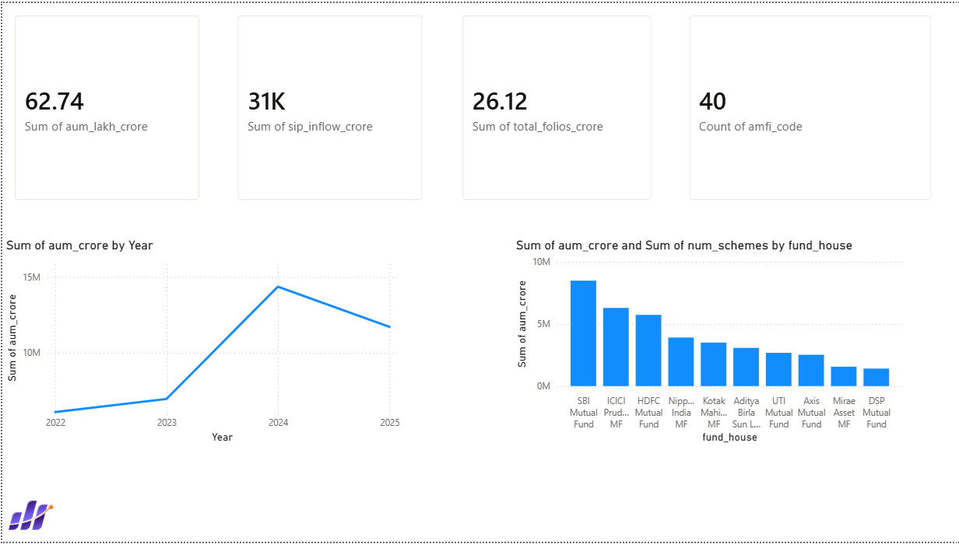
Dashboard: Industry Overview (Page 1)
KPI Cards (Total AUM, SIP Inflows, Folios, Schemes) | AUM Trend Line 2022-2025 | Top 10 AMCs Bar Chart
Bluestock MF Analytics | Damodara P | June 2026

Slide 10
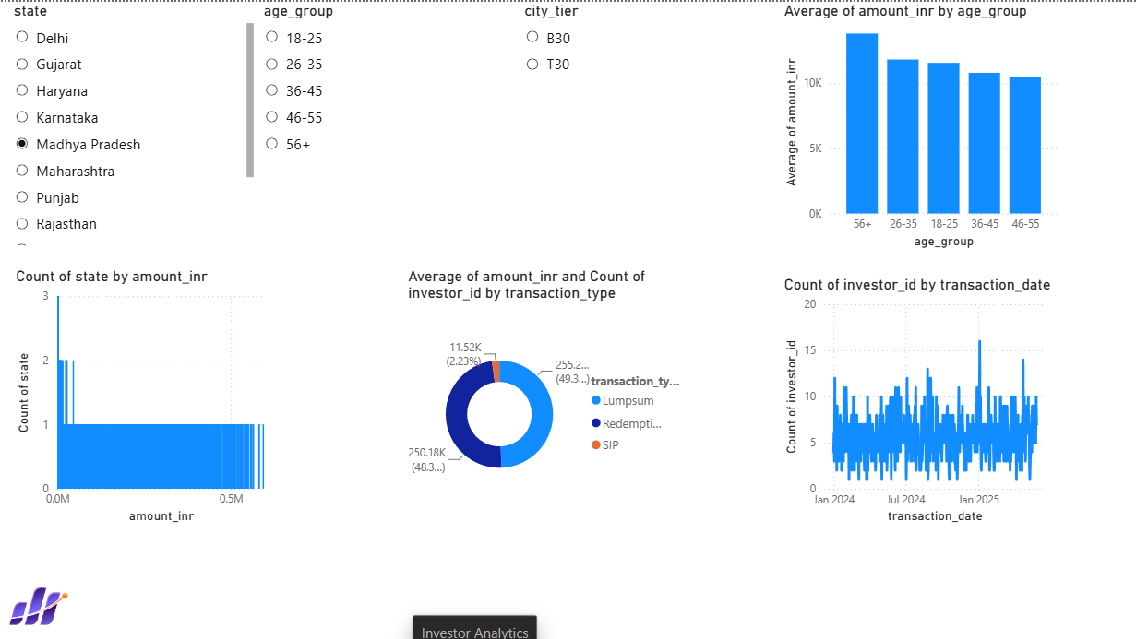
Dashboard: Investor Analytics (Page 3)
Transaction by State | SIP vs Lumpsum vs Redemption Donut | Age Group vs Avg SIP | Monthly Volume Trend
Bluestock MF Analytics | Damodara P | June 2026

Slide 11
Key Findings & Strategic Recommendations
Finding 1 - SIP Resilience: SIP inflows remained structurally resilient even during market corrections (mid-2022 rate hikes), confirming a permanent behavioral shift in Indian retail investing. Monthly SIP contributions never dropped below Rs.12,000 Crore.
Finding 2 - Risk-Adjusted Leaders: Mirae Asset and Kotak funds consistently rank highest on risk-adjusted metrics (Sharpe > 1.3). Some large-cap funds with massive AUM show negative Alpha, suggesting passive index funds may outperform them.
Finding 3 - Tier-2 Opportunity: Tier-2 city investors show 25% higher SIP growth rates than Tier-1, presenting a massive untapped distribution and marketing opportunity for fintech platforms.
Recommendation 1: Integrate Sharpe-based fund rankings as default sort order on Bluestock's platform to protect retail investors from chasing high-Beta, high-return traps.
Recommendation 2: Deploy automated SIP churn alerts using the 35-day gap detection logic to trigger email/SMS retention campaigns for at-risk investors.
Recommendation 3: Expand digital marketing channels targeting 26-35 age group in Tier-2 cities where customer acquisition cost is lower and growth potential is highest.
Recommendation 4: Display HHI-based "Portfolio Concentration" warnings on fund detail pages to help investors make informed diversification decisions.
Bluestock MF Analytics | Damodara P | June 2026

Slide 12
Thank You!
Bluestock Mutual Fund Analytics Capstone
Submitted By: Damodara P
Data Analyst Intern | Bluestock Fintech | June 2026
pdamodaran2000@gmail.com
Questions & Feedback Welcome!

